Slide 1
DEATHS AND CAUSES ACROSS THE GLOBE VISUALIZATIONS
SIREESHA RUSUM

Slide 2
ABSTRACT:
The main abstract of our project is to understand the scenario of deaths that happened across the globe from 1990 to 2019. Our interests are mainly towards the disease like HIV or AIDS, Alzheimer, Alcohol use disorders and digestive diseases. Insights on the growth and decline of diseases over the study period were proposed based on the data visualizations performed. The data visualizations made for the cleaned and pre processed data set.

Slide 3
HYPOTHESIS QUESTIONS:
1. How is the HIV or AIDS disease spread going in recent years across the globe?
2. Which countries are experiencing higher records of alcohol use disorders and digestive diseases in the period of 2014-2019?
3. How the spread of Alzheimer disease is varying from 1990 to 2019 across the globe?

Slide 4
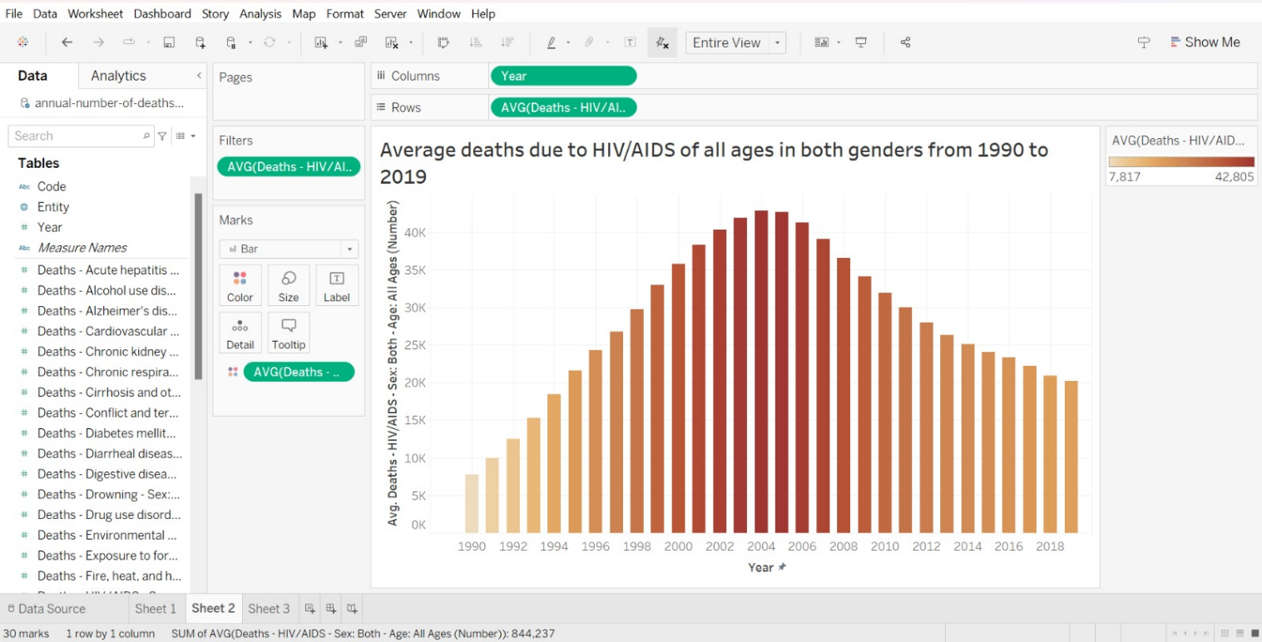

Slide 5
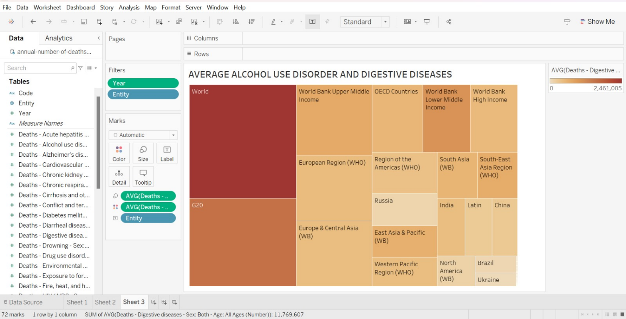

Slide 6
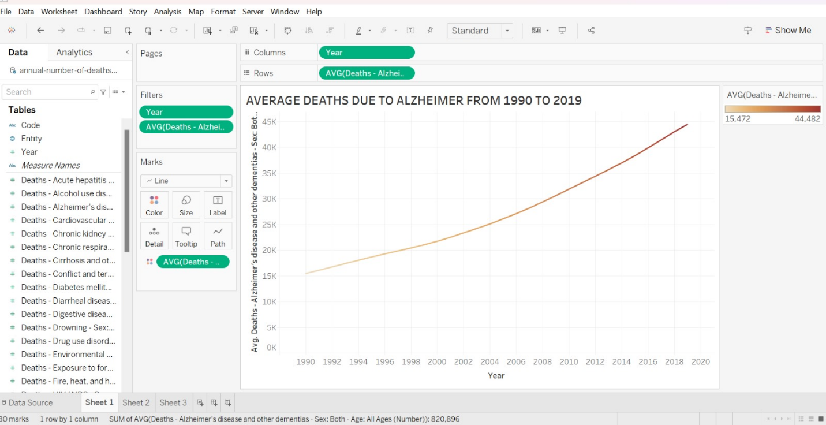

Slide 7
DATA INSIGHTS AND CONCLUSIONS
It can be noted that the cases has increased for Alzheimer constantly from 1990 to 2019. The departments of medicine can take this into consideration to increase the volume of medicine generation over the period. It can also be noted that the cases under this are on rise across the globe. So the medical departments can make trade relationships with other countries. This also leads to increase in merger and acquisition relationships.
The AIDS or HIV cases has shown a sudden fall in cases count across the globe. So, the companies can understand the people’s thoughts regarding the safety measure they adopt while participating in sexual activities. This makes the people to think on getting into the business markets of this area.
It is understood that the alcohol disorders and digestive issues are recorded to be high in the regions of G20 countries, Europe and central Asia along with OECD countries. From this the business people can think on making investments on the medicines R&D’s in these areas of Europe, G20 and central Asia along with OECD countries.

Slide 8
RECOMMENDATIONS:
The data set adopted is partially visualized as it contains a lot of different other diseases information in it. So, further research can be carried out to understand how the declination or rise of diseases is being taken place with respect to time. Further analysis on visualizations can be done for each disease on a continental and regional basis. This will help in putting forward some greater insights for the business people.

